Slide 1

Zurich Real Estate APP
eRum 2018, May 14 2018
A shiny App for
the Zurich real estate market
Max Grütter
Statistical Office of the Canton of Zurich

Slide 2
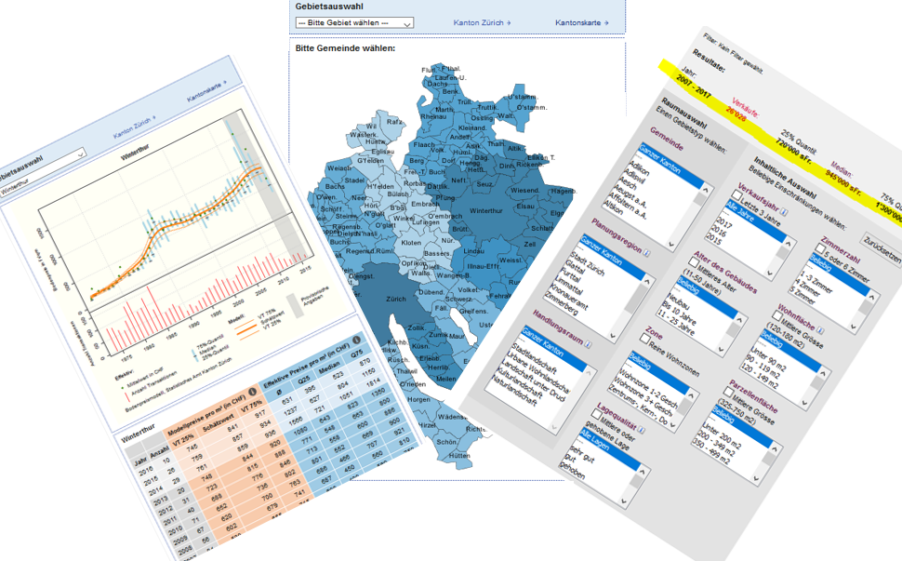
Zurich Real ESTATE DATA
A unique and complete dataset, which you can find on our homepage: statistik.zh.ch/immomarkt
the tools no longer meet the needs of our customers

Slide 3
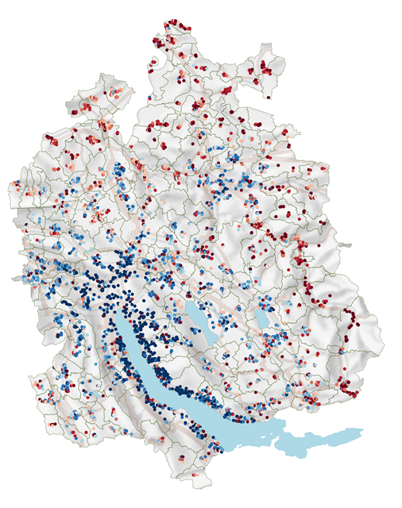
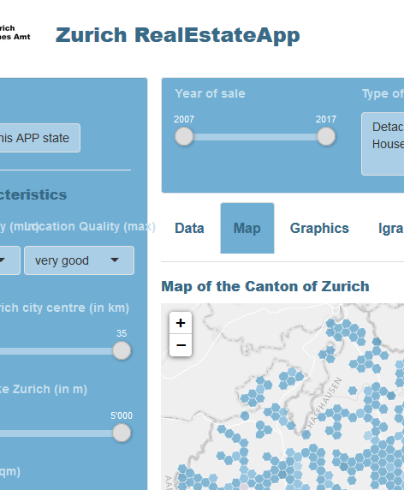
ZHRE APP: CONCEPT
SHINY UI
fluidPage with sidebarLayout and fluidRow
Control widgets:
sliderInput, slectInput, bookmarkButton
Reset with actionButton and shinyjs
conditionalPanel
tabsetPanel
Real Estate Data
filter, mutate, render
ZHRE APP
SHINY SERVER
reactive({})
dplyr::filter
distrr::dcc6
leaflet
ggplot2
plotly

Slide 4
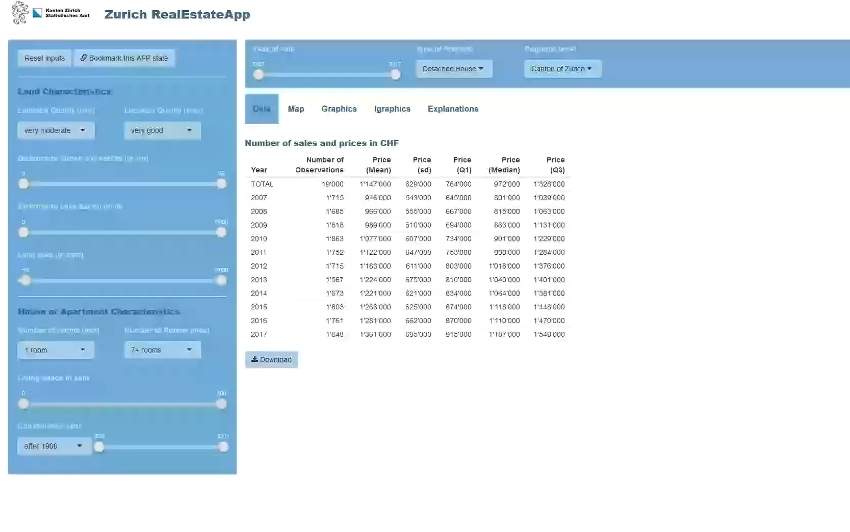
Maxzh.shinyapps.io/zhreapp

Slide 5
ZHRE APP: solved challenges
Data protection
→ hexagon instead of exact coordinates
One app for three statistics
→ conditionalPanel()
great flexibility of the query
→ full Dataset & distrr::dcc6
download of calculated data and graphs
→ reactive({}) & downloadHandler()
Visualisation in a map
→ reactive({}) & leaflet()
Warning if number of observation is to low
→ modalDialog()

Slide 6
ZHRE APP: pending challenges
download Data as Excel including filtersettings
→ work in progress. I've already tried a lot.....
Usability on mobile devices
→ solution without compromising flexibility?
Scalability: One APP for many users
→ this becomes important as soon as we make the app available to our customers
No redrawing of the map if filters are changed
→ should be possible with leafletProxy()
Selection within the map
→ should be possible with crosstalk()

Slide 7






Try out & play yourself: maxzh.shinyapps.io/zhreapp FIND THE CODE OFF THE APP ON MY GITHUB ACCOUNT: github.com/mxgrttr/zhreapp keep in touch: @maxgruetter max.gruetter@statistik.ji.zh.ch
Thank you!
leaflet
distrr
tmap
sp

